Slide 2
Full-Stack JavaScript
Couchbase, node.js, and some AngularJS

Slide 3
Who am I?
Philipp Fehre - Developer Advocate
Twitter: @ischi Github: sideshowcoder

Slide 4
Let’s build something
Notes:
Let’s talk about what we aim for first
Let me introduce you to a couple things first

Slide 5
JSON and JavaScript
Notes:
One language all the way through
JSON is the natural data format

Slide 6
Responsiveness
Notes:
- Users like fast websites
- Slow responses loose engadement

Slide 7
Scalable
Notes:
- We use rest so app servers don’t need to hold state
- We don’t want our database to be the new bottleneck
- Add more node = more power!

Slide 8
Efficiency
Notes:
Lot’s of free users, don’t want to hog resources
node.js is known for being not resources intensive
Couchbase distributes nicely
Rendering is client side

Slide 9
How Do We Get There?

Slide 10
node.js
Event driven programming model
Leads your software development to be fast
Scale out ready
Because of the loose coupling, node can scale out as far as you have machines
However, this means it needs Couchbase
Very efficient use of system resources
Single threaded but multi-process, event driven model ensures good handoff from compute to IO

Slide 11
Couchbase
Sub-millisecond latency
Gives you the consistent performance needed to build complex, interactive game play
Designed for Scale
Add and remove nodes as needed
Efficiency
Couchbase manages system resources such as memory and CPU efficiently

Slide 12
Couchbase
Document database
Store different data types
Counters
Numbers
Strings
JSON

Slide 13
JSON
we all know and love

Slide 14
JSON in node.js
/* $ cat example.json
* {
* "foo": "bar"
* }
*/
var fs = require("fs");
var rawData = fs.readFileSync("./example.json");
var data = JSON.parse(rawData);
console.log("property foo of data:", data.foo);
/* $ node read.js
* property for of data: bar
*/

Slide 15
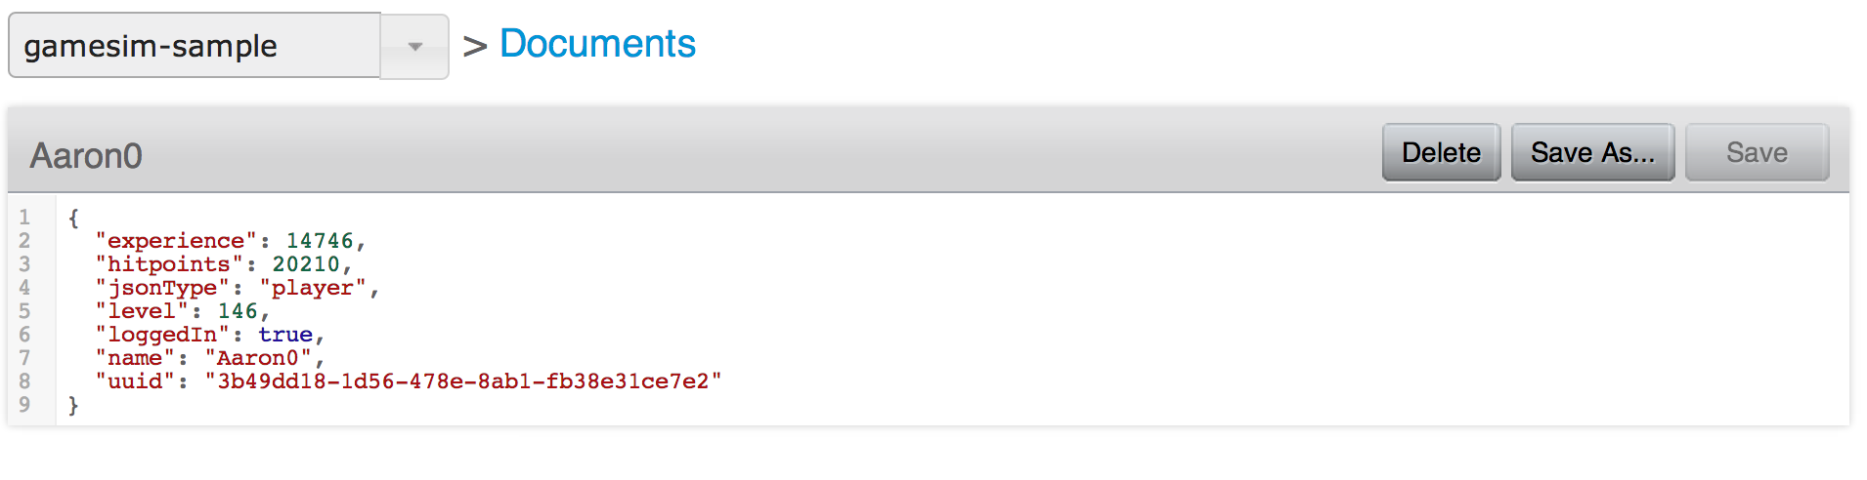
Couchbase & JSON

Slide 16
JSON & Couchbase
Native Data format
Special support for JSON documents is provided
Couchbase recognises JSON as a Datatype
Complex queries
JSON can be handled by the View engine
Build indices via Map / Reduce

Slide 17
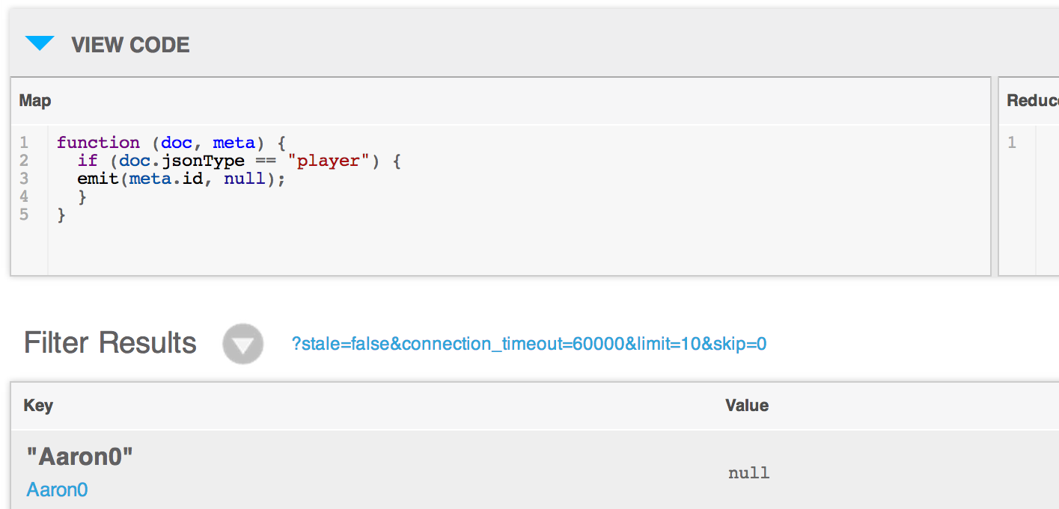
Couchbase Views

Slide 18
JSON as the API
curl https://api.github.com/users/sideshowcoder
{
"login": "sideshowcoder",
"id": 108488,
"avatar_url": "https://avatars.githubusercontent.com/u/…",
"gravatar_id": "5cde19029032f151ca09687f7c8783eb",
"url": "https://api.github.com/users/sideshowcoder",
"html_url": "https://github.com/sideshowcoder",
"followers_url": "https://api.github.com/users/…",
"following_url": "https://api.github.com/users/…",
...
}

Slide 19
JSON in the Browser
<html>
<body>
<script src="/jquery-1.11.0.min.js"></script>
<div id="user-name"></div>
<div id="last-active"></div>
<script>
$.getJSON("https://api.github.com/users/sideshowcoder",
function (data) {
$("#user-name").text(data.login);
$("#last-active").text(data.updated_at);
})
</script>
</body>
</html>

Slide 20
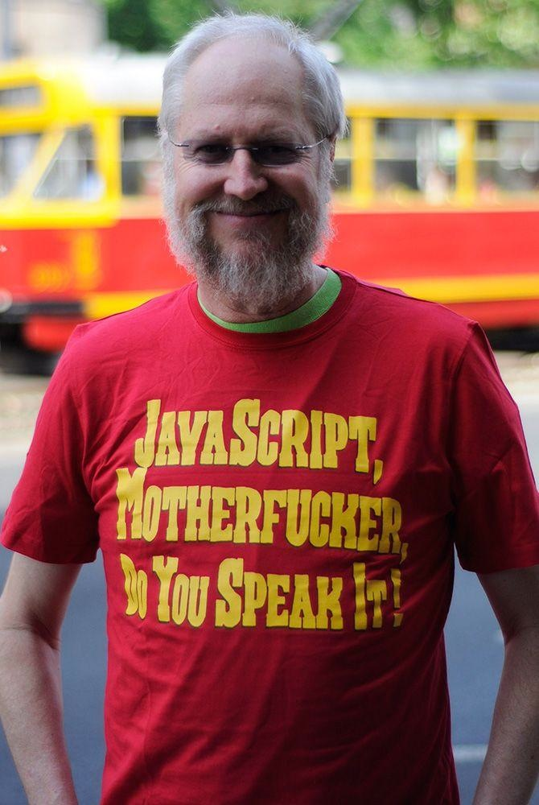
JavaScript is the Programming Language of the Web

Slide 21
Demo

Slide 22


Building an API
with Couchbase, node.js, and AngularJS

Slide 23
Users
Notes:
Sign up
Sign in

Slide 24
app.post("/signup", function (req, res) {
var credentials = req.body
User.create(credentials, function (err, user) {
if (err) {
res.render("signup", { message: err })
} else {
req.session.userId = user.userId
res.redirect("/")
}
})
})
Notes:
Simple route creating a user

Slide 25
app.post("/signin", function (req, res) {
var credentials = req.body
User.authenticate(credentials, function (err, user) {
if (err) {
res.render("signup", { message: err })
} else {
req.session.userId = user.userId
res.redirect("/")
}
})
})
Notes:
Simple route looking up a user
Now we need to store the user somewhere

Slide 26
The Database
Notes:
So how do we use the database

Slide 27
Create a connection
new couchbase.Connection(dbConfig, function(){})
Notes:
That’s simple but we don’t want to create a new one on every request because couchbase uses a smart client architecture

Slide 28
Smart client
Abstracts the cluster
managing connections to all servers
reestablishes failed connection
Manages connection handshake
Transfers and continuously updates the cluster map
Detects cluster configuration changes and abstracts them for the user

Slide 29
Reuse your database connection
var _db = null;
var db = function (cb) {
if (_db) return cb(null, _db);
_db = new couchbase.Connection(dbConfig, function(err) {
if (err) return cb(err);
cb(null, _db);
})
}

Slide 30

Keying
Use a Unique value for key (email, username, sku, isbn, etc.)
example u::phil
Predictable Keys can follow Key-Value patterns
Users typically can be done this way and are the most numerous items
Referential Keys
u::philipp.fehre@gmail.com => u::phil
u::ischi => u::phil
Notes:
Storing for access patterns
In this case key for retrieval by name
Could be extended to use referential keys

Slide 31
Creating a new user
Notes:
lib/user.js
Add, User Data model, Serialisation, Bcrypt

Slide 32
Authentication
Keep in mind GET is quick
Notes:
lib/auth.js

Slide 33
var User = require("./user")
var auth = function (req, res, next) {
if (req.session.userId) {
User.validateId(req.session.userId, function (err, user) {
if (err) {
res.redirect("/signin")
} else {
req.user = user
next()
}
})
} else {
res.redirect("/signin")
}
}
module.exports = auth

Slide 34
Game State
Routes
Notes:
lib/routes.js

Slide 35
app.get("/questions", auth, function (req, res) {
res.set("Content-Type", "application/json")
QuestionList.forUser(req.user, function (err, list) {
if (err) {
res.statusCode = 500
res.end()
} else {
res.end(JSON.stringify(list))
}
})
})

Slide 36
app.post("/questions", auth, function (req, res) {
var questions = req.body
QuestionList.saveForUser(req.user, questions, function (err) {
if (err) {
res.statusCode = 500
return res.end()
} else {
QuestionList.forUser(req.user, function (err, list) {
if (err) {
res.statusCode = 500
res.end()
} else {
res.end(JSON.stringify(list))
}
})
}
})
})

Slide 37
Question List
Notes:
lib/question_list.js

Slide 38
Dealing with concurrency
If a question is answered form two devices at the same time, they collide
We don’t want to accidentally overwrite an answer edit since we’re sending a full document update right after theirs
Retry the operation, if appropriate
[
{
"id": "1",
"text": "What is couchbases upcoming query language called?",
"choices": [
{
"text": "N1QL",
"state": true,
"count": 1,
"id": "a",
"$$hashKey": "00Q"
},
{
"text": "SQL",
"state": false,
"count": 0,
"id": "b",
"$$hashKey": "00R"
},
{
"text": "CQL",
"state": false,
"count": 0,
"id": "c",
"$$hashKey": "00S"
},
{
"text": "NoSQL",
"state": false,
"count": 0,
"id": "d",
"$$hashKey": "00T"
}
],
"$$hashKey": "00M"
},
Actor 1
Actor 2
Success
CAS mismatch & retry
Couchbase Server

Slide 39
QuestionList.prototype.load = function (includeCount, cb) {
var that = this
db.get(this.key, function (err, data) {
if (err) {
…
} else {
that.cas = data.cas
that.questions = data.value
cb(null, that)
}
})
}
QuestionList.prototype.save = function (cb) {
db.set(this.key, this, { cas: this.cas }, cb)
}

Slide 40
Consistent Data
No merging or quorum read needed

Slide 41
The Frontend

Slide 42
AngularJS
Provide views template data bindings
Encapsulate logic in Model-View-“Whatever works”
Templates are based on “enhanced” HTML

Slide 43
Rendering JSON responses
Notes:
public/javascripts/app.js
views/index.jade

Slide 44
One more thing

Slide 45
Showing the answer count

Slide 46
Couchbase Views

Slide 47
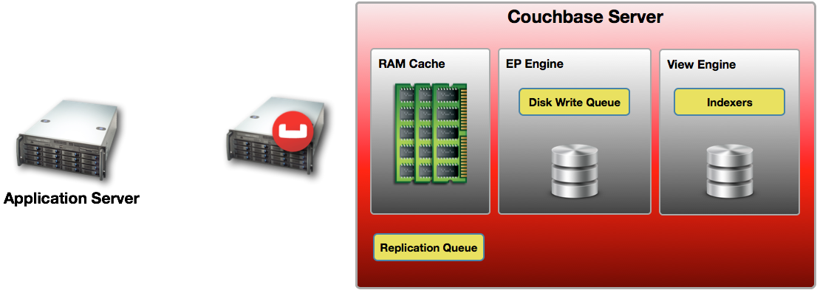
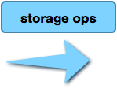






Storage to Index

Slide 48
Creating views with code
var countsDDoc = {
"views": {
"counts": {
"map": "function (doc, meta) { if(doc[0]) {…}”,
"reduce": "_sum"
}
}
}
db.setDesignDoc("ncqa", countsDDoc, function (err, data) {
if (err) {
console.log("failed to setup view.", err)
} else {
console.log("setup view done.")
}
db.shutdown()
})
Notes:
scripts/setup_views.js

Slide 49
Querying the View
QuestionList.prototype.loadCounts = function (cb) {
var that = this
db.conn(function (err, conn) {
var opts = {stale: false, group: true, keys: choicesKeys}
var q = conn.view("ncqa", "counts", opts)
q.query(function (err, results) {
…
})
})
}

Slide 50
Eventual Persistence
Notes:
- data is not persisted “immediately” by Couchbase
- persistence happens after the data passed the disc write queue

Slide 51
When to use and when not to use
views operate on the persisted data
don’t use for “login”
data can be “stale”
Notes:
Counts and alike are ok to be stale
If you have 1M likes it’s ok to be off by 5 for a short amount of time

Slide 52
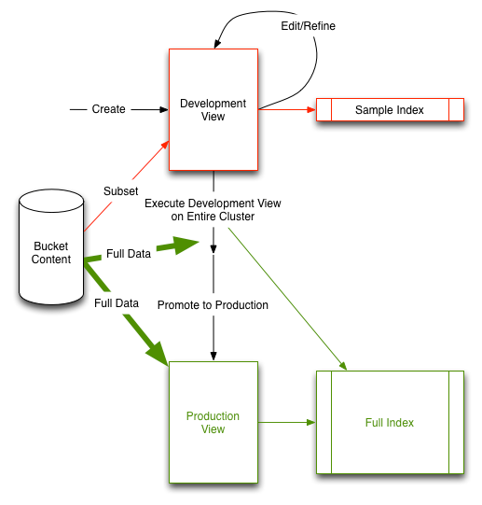
Development vs. Production Views
Development views index a subset of the data.
Publishing a view builds the index across the entire cluster.
Queries on production views are scattered to all cluster members and results are gathered and returned to the client.
Notes:
no downtime deploy?

Slide 53
Couchbase 3.0
Many improvements to views are coming

Slide 54
Watch out for N1QL coming up!

Slide 55
More Demo
Notes:
lib/question_list.js#loadCounts

Slide 56
What to do next…
get the code, set it up, run
https://github.com/couchbaselabs/node-couch-qa
Read Brett's blogs
https://blog.couchbase.com/game-servers-and-couchbase-nodejs-part-1
Write your own! We help you along!
http://www.couchbase.com/communities/nodejs

Slide 57

Resources
https://github.com/couchbaselabs/node-couch-qa
https://github.com/couchbase/couchnode
https://blog.couchbase.com/game-servers-and-couchbase-nodejs-part-1
https://blog.couchbase.com/game-servers-and-couchbase-nodejs-part-2
https://blog.couchbase.com/game-servers-and-couchbase-nodejs-part-3
https://github.com/brett19/node-gameapi

Slide 58
Thank you!
philipp@couchbase.com
Github: @sideshowcoder
Twitter: @ischi
Blog: sideshowcoder.com

